Slide 1

FUNCTIONS IN JAVASCRIPT
Filip Janevski

Slide 2

TOPICS
Function as object
Function invocation
Functional context – the keyword this
Arrow function
Parameters, arguments and properties of functions
High order functions

Slide 3

JAVASCRIPT IS CLASSLESS PROGRAMMING LANGUAGE

Slide 4
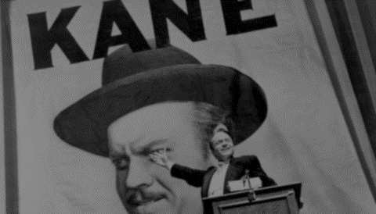
FUNCTIONS ARE FIRST-CLASS CITIZENS IN THE JAVASCRIPT WORLD

Slide 5
PARAMETERS VS ARGUMENTS
Function parameters are names given with the function declaration.
Function arguments are values passed when invoking the function and are assigned to the corresponding function parameters.
JavaScript allows the number of arguments of invocation to not be the same as the number of declared parameters

Slide 6


VARIADIC FUNCTION
Be wise with the arguments property. It might look like an array of values, but it is NOT! You can take the length and do a iteration, but nothing more!
Function with indefinite arity
It can take any number of arguments
arguments - implicit function property

Slide 7

EVERY OBJECT IS EQUAL BUT SOME ARE MORE EQUAL THAN OTHERS

Slide 8

FUNCTIONS CAN BE INVOKED

Slide 9
FUNCTION INVOCATION
My fellow student… there is no only one right way in JavaScript, but there are a lot of wrong ones!
Function can be invoked:
1. Immediately after the page is loaded
2. Later as an callback method
3. IIFE - Immediately Invoked Function Expression
4. call and apply methods
Notes:
callbakc -> usually anonymous functions
IIFE - avoid using global vars

Slide 10
FUNCTION CONTEXT - this
Explicit parameter of every function
It is an object that “owns” the function
Defined on invocation, so it depends on the invocation type!
One function can have different function context when invoked as a function or as a method of an object.

Slide 11

FUNCTION CONTEXT - this
Type of invocation | Context object
as function | Window object
as object’s method | the object on which it is binded
as constructor with new keyword | empty object by default
But… what happens if I want to access the this or the surrounding method from inside a callback?
Notes:
object example with references
direct call instead new by mistake creates global var

Slide 12
FUNCTION CONTEXT - this
You have two solutions:
that is this
use bind()
function Fun(list) {
this.list = list;
this.name = “John”; }
Fun.prototype.iterate = function () { return this.list.map(function (element) { return `${element} ${this.name}`; }); };
Notes:
Function.prototype.bind = function(context, ...arr) {
let that = this;
return function() {
var args = Array.prototype.slice.call(arguments);
return that.apply(context, [...arr, ...args]);
}
}

Slide 13
ARROW FUNCTIONS
Have lexical (static) this - determined by the surrounding scope
Doesn’t bind its own this and arguments properties.
Fun.prototype.iterate = function () { return this.list.map(element => `${element} ${this.name}`); };
Cannot be used as constructor function. Best suited for non-method functions
More compact syntax
Notes:
no binding for this

Slide 14

CURRYIN
CURRYING
FUNCTIONS

Slide 15


HIGH ORDER FUNCTIONS
Function that takes one or more functions as arguments - callbacks
Function that returns a function as its result
Currying - partial evaluation

Slide 16

QUESTIONS

Slide 17
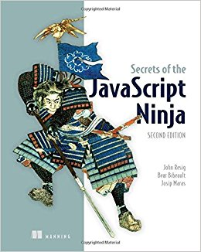
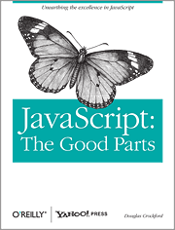
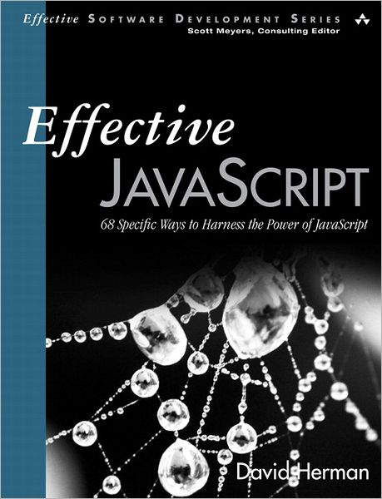
SOURCE

Slide 18

THANK YOU!
Filip Janevski
Hipchat: @jane
Slack: @filip.janevski
Mail: filip.janevski@cuponation.com

